Slide 1



E Commerce
Website
USING JAVA DS DBMS

Slide 2

Name – Aum Motivaras
Roll no – 155
E.No – 23002171310006
B6 - CST
Name – Meet Patel
Roll no – 175
E.No – 23002171310114
B6 - CST
Name – Dev Patel
Roll no – 153
E.No – 23002171310103
B6 - CST
Name –Preya Thakkar
Roll no – 166
E.No – 23002171210182
B6 - CSE
Name – Shrushti Patel
Roll no – 159
E.No – 23002171210126
B6 - CSE

Slide 3
01
Overview

Slide 4

OVERVIEW
This E-commerce project is a comprehensive online shopping platform developed using Java, Data Structures (DS), and Database Management Systems (DBMS).
It involves online platforms, like websites and apps, where businesses and consumers can conduct transactions digitally instead of in physical stores.
E-commerce offers convenience, a wide range of choices, and the ability to shop 24/7 from anywhere with an internet connection.

Slide 5
02
KEY FEATUERES

Slide 6

KEY FEATURES
USER MANAGEMENT
ORDER MANAGEMENT
PRODUCT MANAGEMENT
Allow users to create accounts, log in, and log out securely. Implement password hashing and secure authentication mechanisms.
Maintains a history of all user orders for all purchases.
Creates a structured catalog of products, including categories, subcategories, and product details (name, description, price, stock).

Slide 7
03
USE CASE DIAGRAM

Slide 8
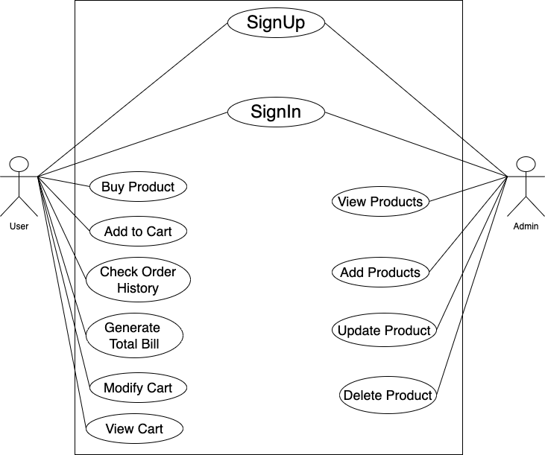

Slide 9
04
ER DIAGRAM

Slide 10
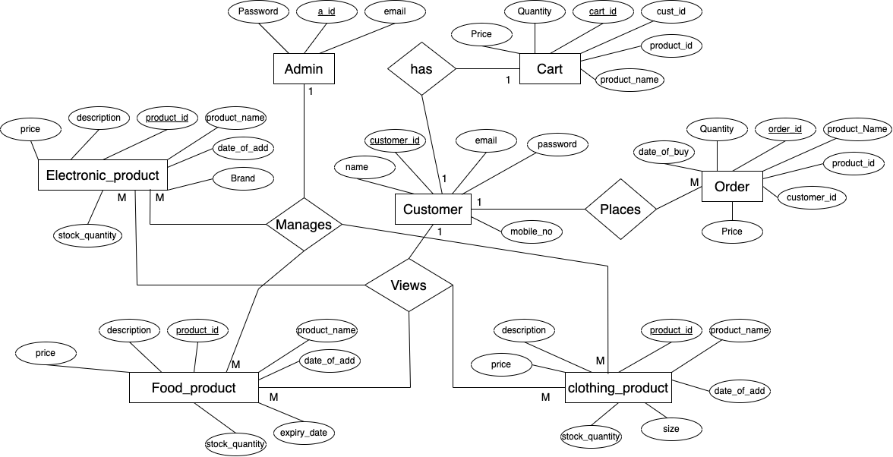

Slide 11
05
Uses of DS, DBMS and JAVA

Slide 12
DS | DBMS | JAVA
IMPLEMENT LINKEDLIST | INSERT,UPDATE,DELETE QUERIES | EXCEPTION HANDLING
HASHMAP | INNER JOIN,CONSTRAINT | COLLECTION FRAMEWORK
ARRAY DEQUEUE | ORDER BY CLAUSE | IO PROGRAMMING
STACK | PROCEDURES,TRIGGER | JDBC

Slide 13
06
MERITS

Slide 14
MERITS
Convenience: You can shop anytime, anywhere, without needing to visit a physical store. This makes it easy to buy what you need with just a few clicks. User Authentication : User authentication ensures secure access and data protection Detailed Product Information : Detailed product information enhances the customer's shopping experience SECURE : Securely and efficiently interact with the database. User-Friendly Interface : A user-friendly menu-based interface simplifies interactions for customers and administrators.

Slide 15
07
DEMERITS

Slide 16
DEMERITS
Lack of Physical Interaction : Customers can't see, touch, or try out products before buying, which can lead to dissatisfaction if the product doesn't meet expectations.
Security Concerns: Online transactions involve sharing sensitive information, such as credit card details, which can be vulnerable to hacking and fraud. Technical Glitches : Websites can experience downtime, slow loading times, or other technical issues that hinder the shopping experience and may cause customers to abandon their purchases Dependence on Internet Access : E-commerce requires a stable internet connection, which can be a barrier for customers in areas with poor connectivity.

Slide 17
08
FUTURE SCOPE

Slide 18
FUTURE SCOPE
Enhanced Data Privacy and Security Measures :As concerns about data privacy grow, e-commerce platforms will need to implement stronger security measures to protect customer information, comply with regulations, and build consumer trust.
Subscription-Based Models : Subscription services for products like food, clothing, and personal care items are expected to grow, providing customers with regular, recurring deliveries of products they need or enjoy.
Growth of Social Commerce : Social media platforms will increasingly integrate e-commerce functionalities, allowing users to shop directly from posts, stories, and ads. This will turn social media into a powerful sales channel.
Faster and More Flexible Delivery Options :Innovations in logistics ,including drone deliveries and autonomous vehicles, will lead to faster and more flexible delivery options, such as same-day or even within-the-hour deliveries.

Slide 19

THANKS!!

